Slide 1
Astronomy Advisory Panel Update
November 2022
Stephen Serjeant (Open University, chair), James Bolton (University of Nottingham), Poshak Gandhi (University of Southampton), Ben Stappers (University of Manchester), Paolo Mazzali (Liverpool John Moores University), Aprajita Verma(University of Oxford), Noelia E. D. Noël (University of Surrey)
These slides are also at https://is.gd/izojaf
Notes:
Hello everyone. Sorry I can’t be there in person. Right now I’m in the middle of nowhere but hopefully by now I’ve managed to dial in. I’ve recorded this talk instead of trusting in 4G technology. What could possibly go wrong? Anyway I’m going to present what we’ve been doing in the Astronomy Advisory Panel, on behalf of everyone on this slide. The slides are also at the URL on the bottom right, and that URL is on all the slides so don’t panic about rushing to note it down.

Slide 2
2021-22 Community Consultation
2022 UKRI Infrastructure Call
Astronomy Advisory Panel UK roadmap 2022
These slides are also at https://is.gd/izojaf
Notes:
So I’m going to talk about three things we’ve been doing: our consultation, the UKRI infrastructure call, and our roadmap.

Slide 3
2021-22 Community Consultation
2022 UKRI Infrastructure Call
Astronomy Advisory Panel UK roadmap 2022
These slides are also at https://is.gd/izojaf
Notes:
First up, our consultation.

Slide 4
These slides are also at https://is.gd/izojaf
Notes:
We ran our consultation with you last year, wrote it up, and over this summer we asked you what you thought. Here’s the astrocommunity mail.

Slide 5
A small number of follow-up comments received on:
EU Horizon programmes
UKSA – desire for science exploitation to remain in STFC remit
The disconnect between facility time awards (including DIRAC) and exploitation funding
Insufficient discussion of UK interests in gravitational wave astronomy and its technology
Equity, Equality, Diversity, Inclusion
No major rewrites; gravitational wave astronomy now also covered in Particle Astrophysics Advisory Panel roadmap
In addition to consultation responses, 62 white papers received (of which more later)
Current consultation summary is at https://is.gd/osehav
These slides are also at https://is.gd/izojaf
Notes:
We didn’t get a lot of feedback. Maybe everyone’s consulted-out? Maybe everyone’s flat-out because of the pandemic and more. Anyway, you told us about EU Horizon programmes, keeping UKSA science in the STFC remit, and the perennial disconnect between facility time awards and grants. We had a substantial request for more discussion of gravitational wave astronomy, as well as EDI comments.
All in all these didn’t mean major re-writes, and gravitational waves are now also in the Particle Astrophysics roadmap.
We also got 62 white papers, of which more later.

Slide 6
2021-22 Community Consultation
2022 UKRI Infrastructure Call
Astronomy Advisory Panel UK roadmap 2022
These slides are also at https://is.gd/izojaf
Notes:
ok so next up

Slide 7
2021-22 Community Consultation
2022 UKRI Infrastructure Call
Astronomy Advisory Panel UK roadmap 2022
These slides are also at https://is.gd/izojaf
Notes:
is the infrastructure call.

Slide 8
These slides are also at https://is.gd/izojaf
Notes:
UKRI wanted ideas from the constituent research councils, and the research councils in turn ask the advisory panels to trawl their communities. So we did, in this email. But there was huge demand management. Each advisory panel could only suggest 3 projects to STFC. Then STFC decides on a TOTAL of just three to go forward to UKRI.

Slide 9
Submissions in no priority order:
A 10-12-metre spectroscopic survey telescope. Design study for Mauna Kea Spectroscopic Explorer and/or ESO Widefield Spectroscopic Telescope; very wide range of science; natural next step for Vera Rubin Observatory and ESA Euclid follow-ups. ASTRONET priority and featured in AAP white papers.
The next generation instrumentation suite for the Extremely Large Telescope. Design study for 2nd generation of ELT instruments: MOSAIC, ANDES, PCS. PPRP funding for phase A and R&D, but not capital or hardware costs. Unlike previous VLT and 1st-generation ELT instruments, ESO will not provide hardware costs for 2nd & 3rd generation ELT instruments; hardware funds to be found by instrument consortia. Also featured in the AAP call for white papers.
Scalable continuum cameras for sub-mm telescopes. Design study for 1st-generation AtLAST instrument. AtLAST facility design study funded by EU Horizon 2020. In the process would deliver a wide-field continuum camera for the JCMT (tactical and strategic advantage for ALMA in many science areas). ASTRONET priority and in AAP white papers.
UK Extreme High Frequency Facility. Technology development hub for coherent detectors from radio to sub-mm, for SKA, ALMA etc. Wide range of science themes.
Joint Rubin–Euclid data processing. Rubin LSST time-domain and optical filters complement Euclid spatial resolution and near-IR. Rubin+Euclid comprehensively studied wide-ranging science cases from combining these data. Project proposed to create new value-added data products from joint analysis.
Submitted to STFC...
In reserve for next UKRI call / STFC actively seeking other UKRI opportunities
These slides are also at https://is.gd/izojaf
Notes:
Here’s what we got, in no particular order. A 10-12m class spectroscopic survey telescope, like the Mauna Kea Spectroscopic Explorer. Very wide range of science, natural next step for Rubin and Euclid follow-ups, widely supported.
The next generation instruments for ELT. They’d had PPRP funding for phase A and R&D, but no hardware costs, and ESO don’t fund that. Again, very wide science and widely supported.
Scalable continuum cameras for submm telescopes. This was an instrument study for AtLAST, which in turn had had a design study funded by Horizon. A nice touch was that this study would have the happy side effect of delivering a new wide-field continuum camera for the JCMT. Again, wide science and widely supported.
The UK Extreme High Frequency Facility. This was an idea for a tech development hub for submm to radio. It’s a nice idea but was a bit of a late bid so we wanted to keep this one in reserve for the next call. It does also show that the submm community isn’t speaking with a single voice or vision though, unlike for example the CMB cosmology community.
Joint Rubin-Euclid data processing. Two very complementary facilities, with very broad science and community support and a need for new joint data products.
So, we ran these past UKRI informally to see what would have the best chance, and got the feedback that the Rubin-Euclid one wouldn’t be a perfect fit. So we went with these three to submit to STFC. For the other two, they’re either in reserve for the next call, or STFC are actively seeking other UKRI opportunities. It did highlight to us though that there wasn’t a natural place for new digital infrastructure work to land, because existing STFC lines had no headroom, which I’ll come back to in our roadmap.

Slide 10
2021-22 Community Consultation
2022 UKRI Infrastructure Call
Astronomy Advisory Panel UK roadmap 2022
These slides are also at https://is.gd/izojaf
Notes:
ok so onto

Slide 11
2021-22 Community Consultation
2022 UKRI Infrastructure Call
Astronomy Advisory Panel UK roadmap 2022
These slides are also at https://is.gd/izojaf
Notes:
our roadmap.

Slide 12
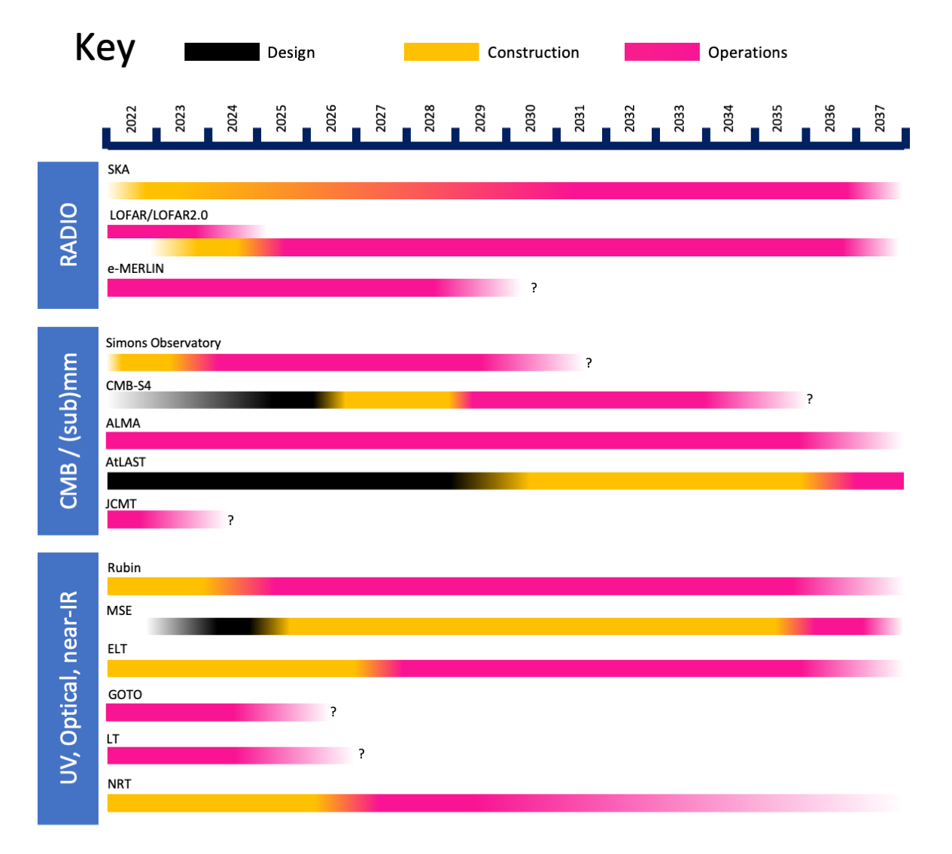
These slides are also at https://is.gd/izojaf
Notes:
Advisory panels are required by Science Board to come up with science and technology roadmaps. The last AAP one was ten years ago, so it badly needed doing. But since then STFC have created the Balance of Programmes reviews which is where the near-term tensioning happens, so the remit’s a bit different and the criteria more nebulous. We also don’t want to create any hostages to fortune by fine-grained ranking against nebulous criteria, so this means our rankings are coarser-grained. Also, this isn’t about us ranking your science. This is you telling us what’s important to you, and us reporting this onwards to Science Board, which we’ll be presenting to Science Board in a couple of weeks. After that I expect this will be released by STFC and if arXiv let us we’ll put it on there too.

Slide 13
Overarching top priority: exploitation (i.e. grants)
Top priorities:
European Southern Observatory, including VLT, ELT, ALMA etc
Square Kilometer Array
European Space Agency and other space opportunities
“The ESA Science mandatory programme is formally outside the STFC remit, except e.g. in the science exploitation of current or past missions in AGP, and occasionally in preparatory technology or software infrastructure development for science in PPRP. Nevertheless it covers projects supporting almost the entirety of the UK astronomy science and technology communities, with missions comparable (or greater) in cost, impact and community support to our highest-rated ground-based projects, e.g. JWST, Athena, Ariel, Plato, Euclid, LISA etc.”
These slides are also at https://is.gd/izojaf
Notes:
The overarching top priority is grants. Duh. Now there’s been a recent very welcome uplift for this year and going into future years, but most of it hasn’t happened yet so at this stage we’re not minded to change this overarching top priority.
In terms of specific top priorities, we have ESO and all that comes with it, and the SKA. Also we’ve lumped together all of the space activities as a single combined top priority, for the reasons on the slide – but also, between ourselves, so we don’t create any hostages to fortune later on, because of let’s say insufficiently well briefed policy makers spotting the word European. We’re also very careful not to pre-empt the independent decisions of AGP or PPRP.

Slide 14
Very high priorities:
High performance computing
Vera Rubin Observatory
Simons Observatory
High priorities: WEAVE; MKSE / other massively multiplexed 10m-class spectroscopy; LOFAR; VLT BlueMUSE; VLT CUBES; UKNRAO; AtLAST / submm astronomy on large scales; MROI; HARPS-3. AAP added: UK roles in DESI, CCAT, 4MOST; VLT/MOONS; GOTO; CTA (UK technical interests in instrumentation and science interests in multi-messenger astronomy); laboratory astrochemistry; crowd-sourced astrophysics.
Emerging community priorities: Space Domain Awareness; mm/submm line intensity mapping; DARA; Goonhilly astronomy collaboration; SETI techno-signatures
These slides are also at https://is.gd/izojaf
Notes:
Very high priorities that you’ve told us are HPC and Rubin. The CMB community have been absolutely clear that their overwhelming top priority is Simons Observatory, so we felt we had to make that clear here too.
Our high priority facilities are all these, which I won’t read out, but are all the obvious stuff.
We also had some very nice imaginative white papers in other areas that we’ve put under the heading of emerging community priorities.

Slide 15
Recommendation 2.1: The 2022 AAP Science and Technology Roadmaps should not be used in isolation to evidence current community support without further reference to AAP, because astronomy is a fast-paced and rapidly changing field. Nor should these roadmaps be used to draw a funding threshold line in the event of changes to the core programme funding, because the Balance of Programmes Review (or a hypothetical Astronomy-specific near-term tensioning exercise) is the appropriate process for that.
Recommendation 3.1: STFC and UKSA should support the UK exoplanet community in developing a stellar variability and extreme precision radial velocity roadmap in liaison with other international bodies such as ESA, ESO, NASA, NSF etc.
Recommendation 3.2: STFC should prioritise increasing the exploitation line, which is the community’s top priority.
These slides are also at https://is.gd/izojaf
Notes:
Our key recommendations start with this. Firstly, don’t abuse the roadmap. Don’t use it blindly without further reference to AAP. Don’t use it to draw a funding threshold line. That’s not what it’s for.
Secondly, this specific recommendation came from the exoplanet community and we’re happy to endorse it. This request covers AAP, SSAP, UKSA interests and more.
Thirdly, grants are still your top priority.

Slide 16
Recommendation 3.3: UK association to the EU Horizon funding programme is critical for astronomy. Replacing the funding alone would alleviate the exploitation pressure but would disconnect the UK from continental-sized research networks.
Recommendation 3.4: STFC should review the career structure for instrumentation and technical roles, both within and beyond astronomy and discuss with Universities as to how to implement that within their structures.
Recommendation 3.5: STFC must maintain the UK role in the SKA and support the development of the UK SKA Regional Centre.
Recommendation 3.6: The UK must remain a member of the European Southern Observatory and play leading roles in its development of its world-class instrumentation, including the second- and third-generation instrument suite of the ELT and the development of ALMA instrumentation.
These slides are also at https://is.gd/izojaf
Notes:
Horizon funding is critical. If government just replaces the money, that still cuts us off from continental-sized research networks.
The career structure for instrumentation and technical roles. This came up in a lot of our community feedback and white papers, so we’re asking STFC to take a broader review.
The SKA is critical.
And so is ESO.

Slide 17
Recommendation 3.7: UK HPC capabilities such as DiRAC & IRIS underpin a wide range of world-leading UK theoretical astrophysics and data science that must be continually supported and upgraded to remain competitive.
Recommendation 4.1: STFC (via AAP) should commission a review of UK submm/mm-wave science and technology, covering UK aspirations for current and future large single-dish facilities that feed the major international interferometers, and the underpinning aspirations for next-generation instrumentation, identifying areas of international excellence.
Recommendation 4.2: There should be increased support for digital infrastructure in UK astronomy, including the creation of value-added data and software products, open science, and the development and implementation of machine learning technologies.
Recommendation 5.1: There must be strong UK investment in a broad programme of advanced instrumentation and its supporting technologies, including (but not limited to) precision optomechanics, (astro)photonic technology, nm-resolution metrology, sensor development, kinetic inductance detectors and infrared detectors in general, CCDs and CMOS detectors, receiver development, low noise high-electron-mobility transistors, device fabrication capabilities, software and computing.
These slides are also at https://is.gd/izojaf
Notes:
HPC underpins a lot of our success and must be supported.
We’d like to see the UK submm community come together to create a single vision and priority list, because as we’ve found the community isn’t speaking with one voice at the moment, but we think it would be very helpful for them to follow the lead of the CMB cosmology community.
We’d like to see more support for digital infrastructure. As I mentioned earlier, this was prompted by us struggling to find a landing place for the Euclid-Rubin joint data products.
We’d asked you what your priority technology development areas are, but we got a VERY strong steer that the best way for the UK to use astronomical technology to leverage science leadership, is to have diversity in the technologies. Don’t try to pick winners.

Slide 18
Recommendation 5.2: The ESA mandatory science programme covers projects supporting almost the entirety of the UK astronomy science and technology communities, with missions comparable (or greater) in cost, impact and community support to our highest-rated ground-based projects. The UK must continue ESA membership, and there is widespread astronomy community appetite for exploring bilateral space agreements and other space opportunities.
Recommendation 5.3: Maintaining UK access to the top priority facilities is not sufficient to ensure returns on these major investments, so STFC should maintain and develop a broad portfolio of high/very high priority science facilities, including (but not limited to) WEAVE, LOFAR, JCMT, GOTO, LT/NRT, WASP, NGTS, DIRAC, IRIS, e-MERLIN, Lovell Telescope, among current facilities, and UK roles in e.g. DESI, CCAT, 4MOST, BlackGEM, as well as fostering roles in currently non-STFC-supported projects such as REACH; looking further ahead, HARPS-3, Rubin LSST, Simons Observatory, AtLAST, MSE, CTA, VLT/MOONS. As part of this broad portfolio supporting the highest priority science, AAP further recommends support for laboratory astrochemistry.
These slides are also at https://is.gd/izojaf
Notes:
We’ve got to be in ESA.
And finally, having UK access to the few giant facilities is not enough to ensure science returns. We need to maintain and develop a broad portfolio of high and very high priority activities. The ones listed here are not an exclusive list.

Slide 19
Any questions?
These slides are also at https://is.gd/izojaf
Notes:
And that’s it! I hope we’ll have the report on arXiv before the end of the year, and at least circulated via AstroCommunity.

